Slide 1
Insertion sort Subject:- Dsa
Present By: Uzma Banu

Slide 2
Introduction Of Insertion Sort
Insertion Sort is a sorting algorithm that works by repeatedly taking one element from an unsorted list and inserting it into its correct position in a sorted portion of the list. The process is repeated until the entire list is sorted.

Slide 3
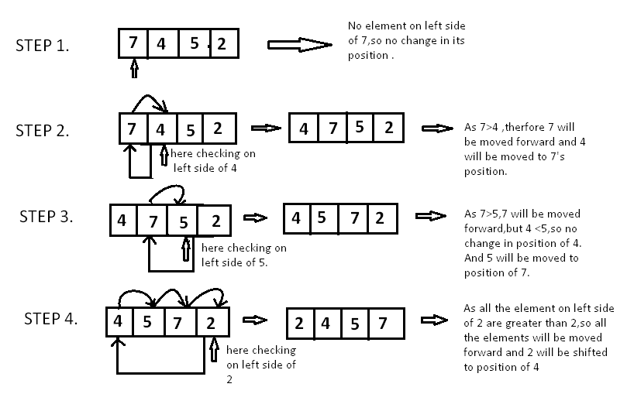
Visual Representation

Slide 4
Characteristics of Insertion Sort
This algorithm is one of the simplest algorithms with a simple implementation.
Basically, Insertion sort is efficient for small data values.
Insertion sort is adaptive in nature, i.e. it is appropriate for data sets that are already partially sorted.

Slide 5
Use Case of Insertion Sort
Contact Lists:
Efficient for alphabetically sorting contacts on mobile devices.
Real-Time Applications:
Ideal for sorting small datasets in real-time scenarios.
Resource Efficiency:
Requires minimal resources, making it suitable for applications with constraints.
Simplicity:
Simple implementation for straightforward sorting tasks.

Slide 6
Advantages of Insertion Sort
Simple Implementation: Easy to understand and implement.
Efficient for Small Lists: Performs well with small or nearly sorted datasets.
Adaptive: Works efficiently with partially sorted lists.

Slide 7
Disadvantages of Insertion Sort
Inefficiency with Large Datasets:
Insertion Sort becomes impractical and slow for sorting large lists, as its time complexity grows quadratically.
Not Suitable for Linked Lists:
Inefficient for linked lists compared to array-based implementations due to frequent element shifting.

Slide 8
Algorithm of Insertion Sort
Step 1 :- Start
Step 2 :- Input a[5]
Step 3 :- Set I <- 1
Step 4 :- Repeat step 5 to 9 while(i<5)
Step 5 :- Set j <- i
Step 6 :-Repeat step 7 to 8 while(j>=1)
Step 7 :- if a[j-1] > a[j] then
Set temp <- a[j-1]
a[j-1] <- a[j]
a[j] <- temp
Step 8 :- j <- j-1
Step 9 :- i <- i+1
Step 10 :- print a[5]
Step 11 :- Exit

Slide 9
Implementation of Insertion Sort With C
#include<conio.h>
#include <stdio.h>
void insertionSort(int arr[], int n) {
int i, key, j;
for (i = 1; i < n; i++) {
key = arr[i];
j = i - 1;
// Move elements of arr[0..i-1] that are greater than key to one position ahead of their current position
while (j >= 0 && arr[j] > key) {
arr[j + 1] = arr[j];
j = j - 1;
}
arr[j + 1] = key;
}
}

Slide 10
void printArray(int arr[], int size) {
int i ;
for (i = 0; i < size; i++)
printf("%d ", arr[i]);
printf("\n");
}
int main() {
clrscr();
int arr[] = {12, 11, 13, 5, 6};
int n = sizeof(arr) / sizeof(arr[0]);
printf("Array before sorting:\n");
printArray(arr, n);
insertionSort(arr, n);
printf("Array after sorting:\n");
printArray(arr, n);
getch();
return 0;
}

Slide 11
Output
Array before sorting:
12 11 13 5 6
Array after sorting:
5 6 11 12 13

Slide 12
Thanks...!

